Slide 1
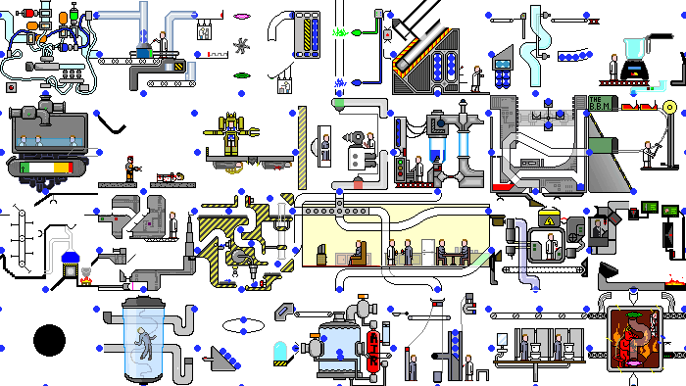
GPars:
Unsung Hero of Concurrency in Practice
http://playstationna.i.lithium.com/t5/image/serverpage/image-id/432281iDADEAFC04868CE5C?v=1.0

Slide 2
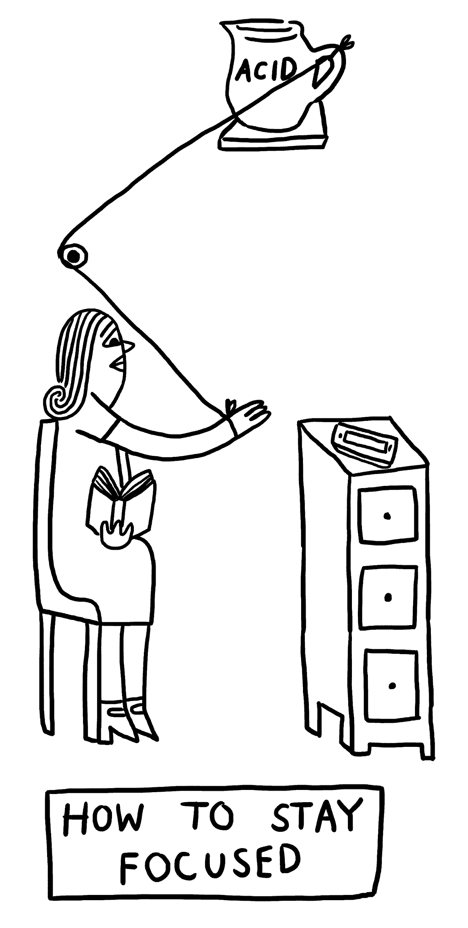
Focus for this talk
When it comes to concurrency and parallelism,
first things to appear in someone’s mind may be “Java Concurrency in Practice” by Brian Göetz, threads, java.util.concurrent, Fork-Join, parallel streams, reactive, Akka or MapReduce.
When it comes to Groovy, first things to appear in someone’s mind may be Gradle, Grails, Spock, DSLs or scripting.
http://www.theverge.com/2015/4/22/8381963/rube-goldberg-machine-contest-history-ideas

Slide 3
Focus for this talk
Great injustice is that you rarely meet GPars in both these lists.
Framework that provides high-level APIs and DSLs for writing concurrent and parallel code both in Java and Groovy
and support for concepts of map/reduce, fork/join, asynchronous code, actors, agents, dataflows (not all mentioned) deserves a little more attention, isn’t it?
http://www.theverge.com/2015/4/22/8381963/rube-goldberg-machine-contest-history-ideas

Slide 4
Focus for this talk
In this talk we will try to fix it. One by one, we will explore various use cases of GPars with all its pragmatism and conciseness.
Not forgetting neither plain Java nor Groovy adepts, we will use Groovy to empower our solutions and ensure that everything works from Java the same way.
http://www.theverge.com/2015/4/22/8381963/rube-goldberg-machine-contest-history-ideas

Slide 5
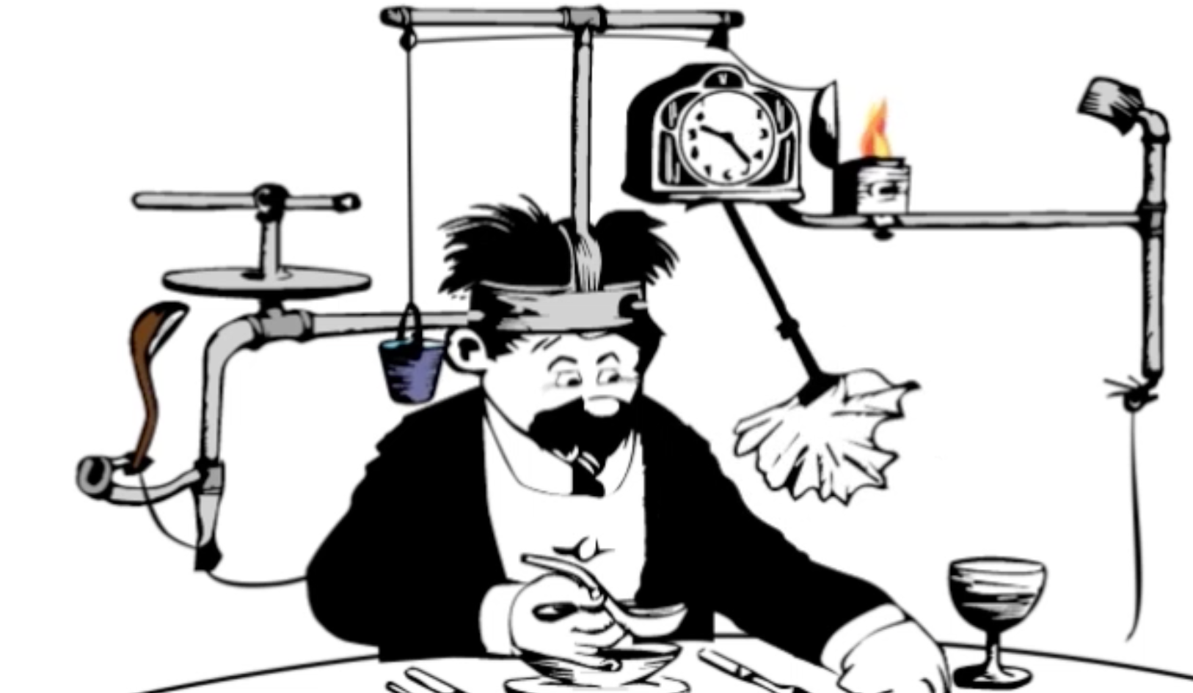
Yaroslav Yermilov Senior Software Engineer EPAM Systems yermilov17@gmail.com https://yermilov.github.io/ https://twitter.com/yermilov17 https://www.facebook.com/yaroslav.yermilov https://ua.linkedin.com/pub/yaroslav-yermilov/58/682/506
work for EPAM Systems since 2011 distributed systems, Big Data and automated testing out of office - Groovy
https://motherboard.vice.com/en_us/article/inside-rube-goldberg-machine-youtube-video-artist-joseph-herschers-bedroom-workshop

Slide 6
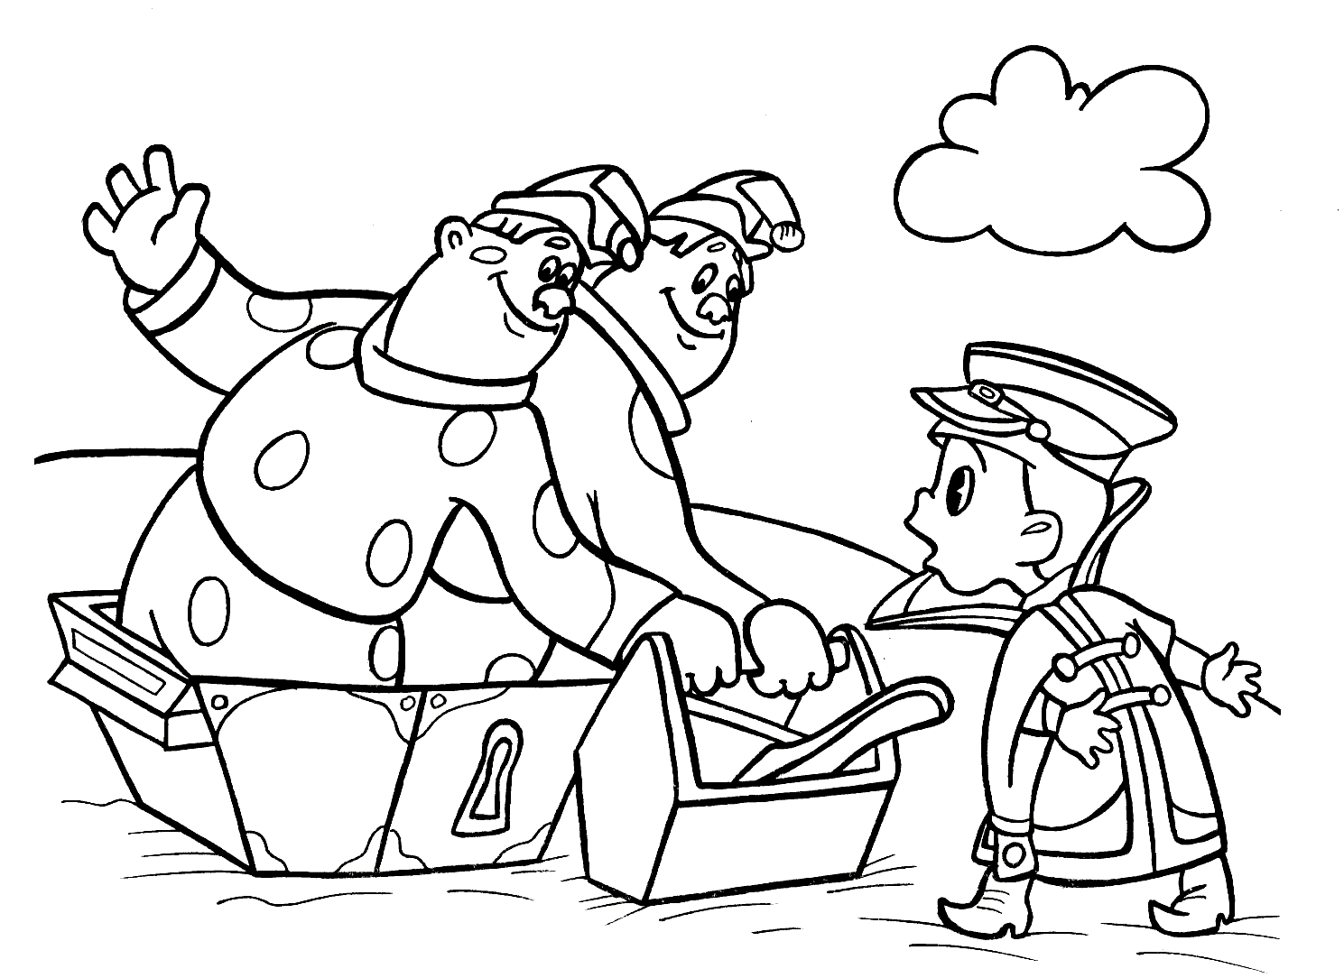
two guidelines for developing concurrent code

Slide 7
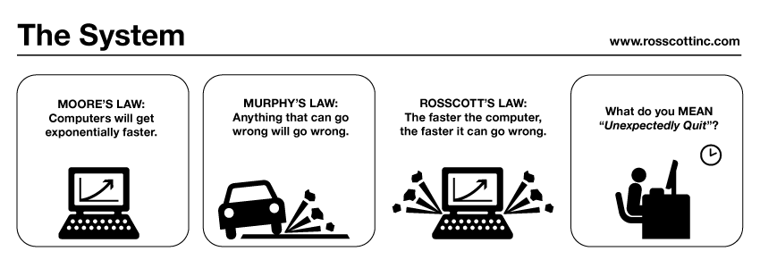

guideline #2 for developing concurrent code
public class Holder {
private int n;
public Holder(int n) { this.n = n; }
public void assertSanity() {
if (n != n) {
throw new AssertionError("Even it can go wrong!");
}
}
}
public class Initializer {
public Holder holder;
public void init() { holder = new Holder(42); }
}
public class Holder {
private int n;
public Holder(int n) { this.n = n; }
public void assertSanity() {
if (n != n) {
throw new AssertionError("Even it can go wrong!");
}
}
}
public class Initializer {
public Holder holder;
public void init() { holder = new Holder(42); }
}
MURPHY’S LAW:
Anything that can go wrong will go wrong.
Holder was not properly published!
http://www.systemcomic.com/2009/04/27/the-system-197

Slide 8
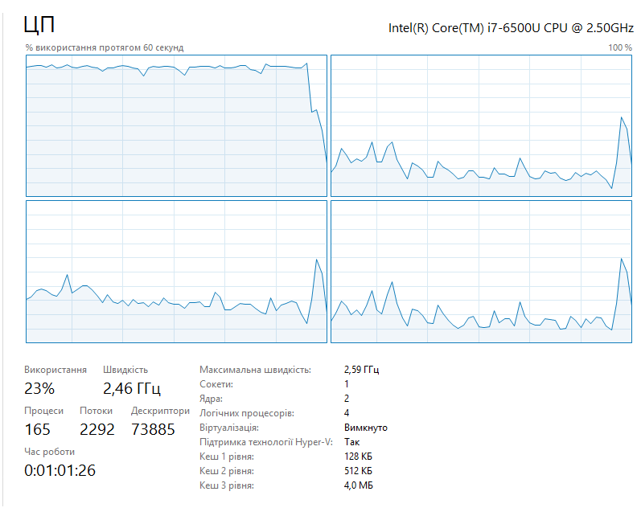
guideline #1 for developing concurrent code
MOORE’S LAW:
Computers will get exponentially faster.
your code may not
http://www.systemcomic.com/2009/04/27/the-system-197

Slide 9
two guidelines for developing concurrent code
Java toolbox

Slide 10
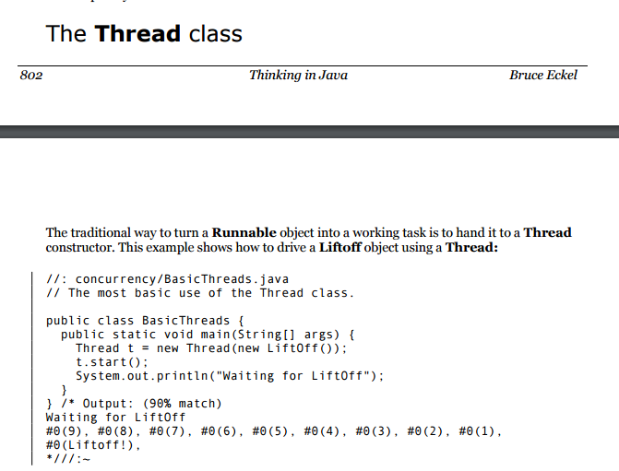

Slide 11
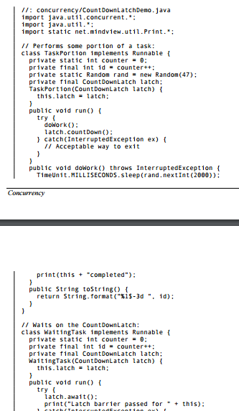
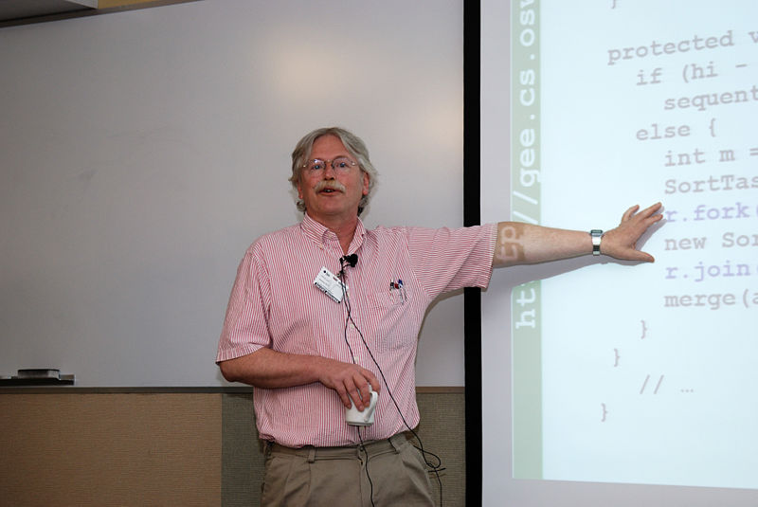
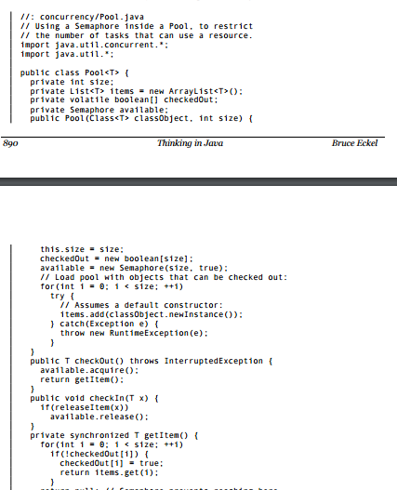
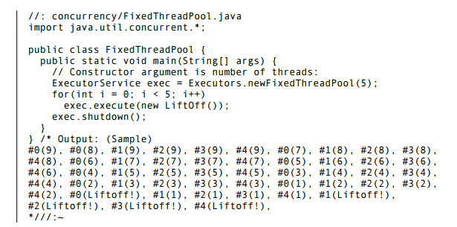
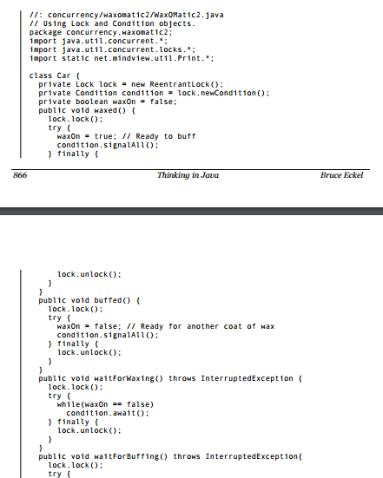
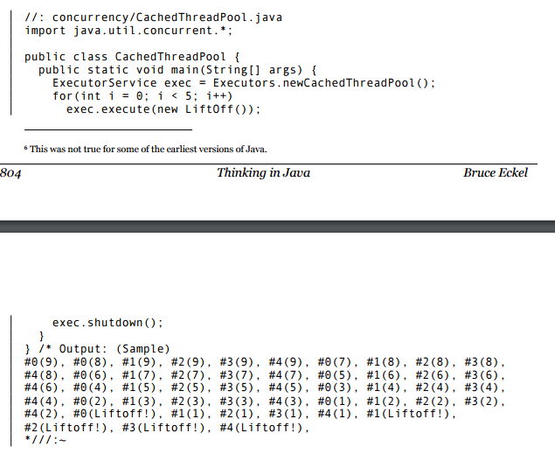
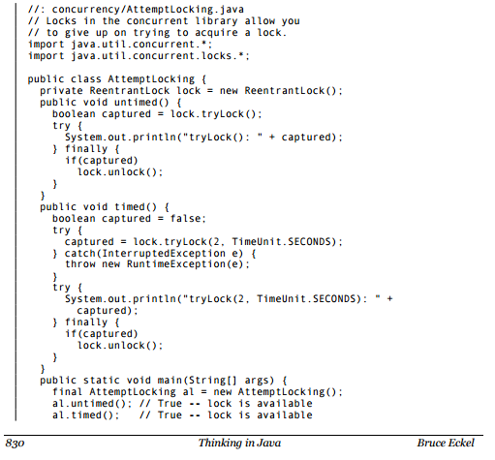
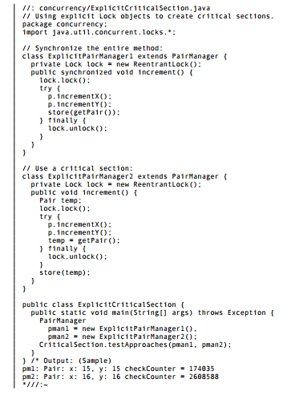
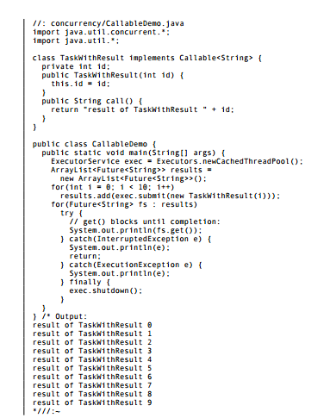
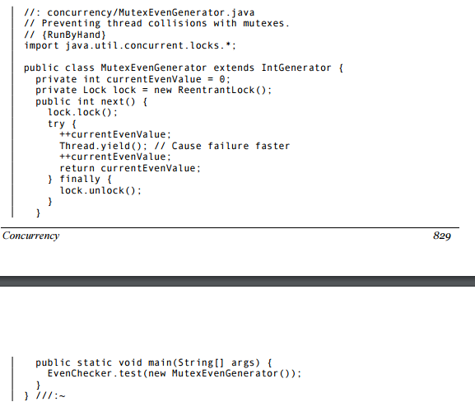
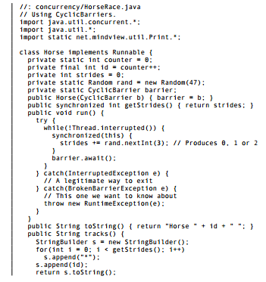
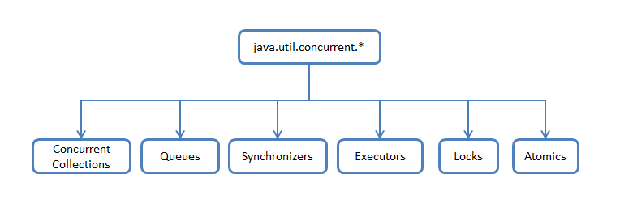
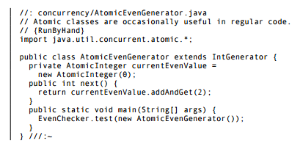
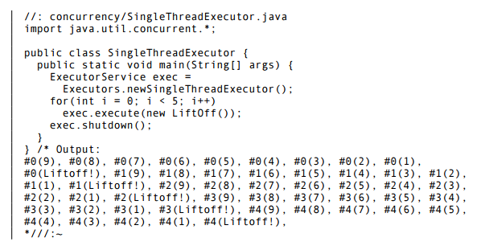

Slide 12
two guidelines for developing concurrent code
developer
Java toolbox

Slide 13
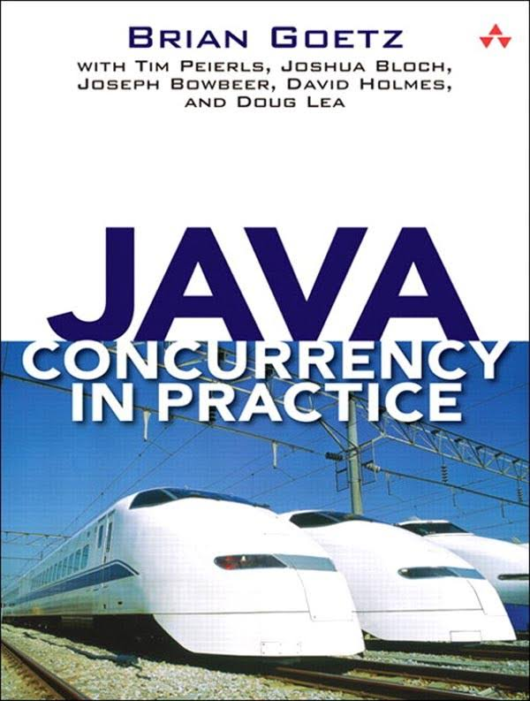
If multiple threads access the same mutable state variable without appropriate synchronization, your program is broken.
There are three ways to fix it:

Slide 14
If multiple threads access the same mutable state variable without appropriate synchronization, your program is broken.
There are three ways to fix it:
Don’t share the state variable across threads

Slide 15
If multiple threads access the same mutable state variable without appropriate synchronization, your program is broken.
There are three ways to fix it:
Don’t share the state variable across threads
Make the state variable immutable

Slide 16
If multiple threads access the same mutable state variable without appropriate synchronization, your program is broken.
There are three ways to fix it:
Don’t share the state variable across threads
Make the state variable immutable
Use synchronization whenever accessing the state variable

Slide 17
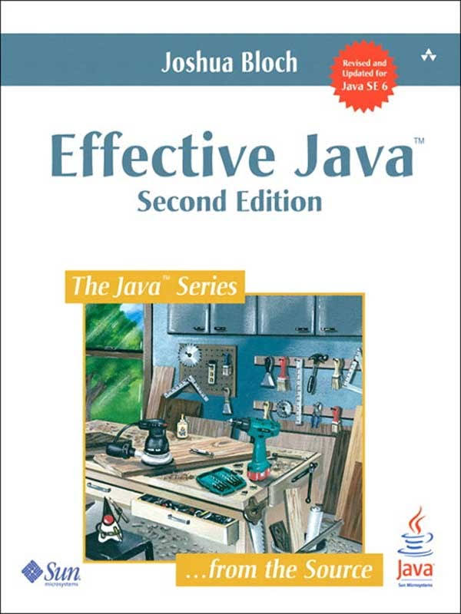
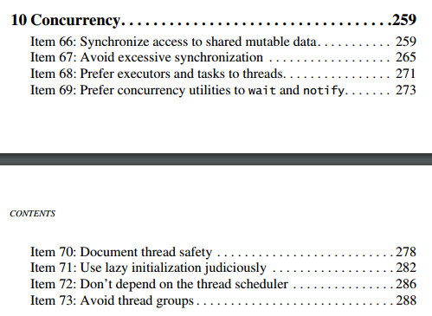

Slide 18
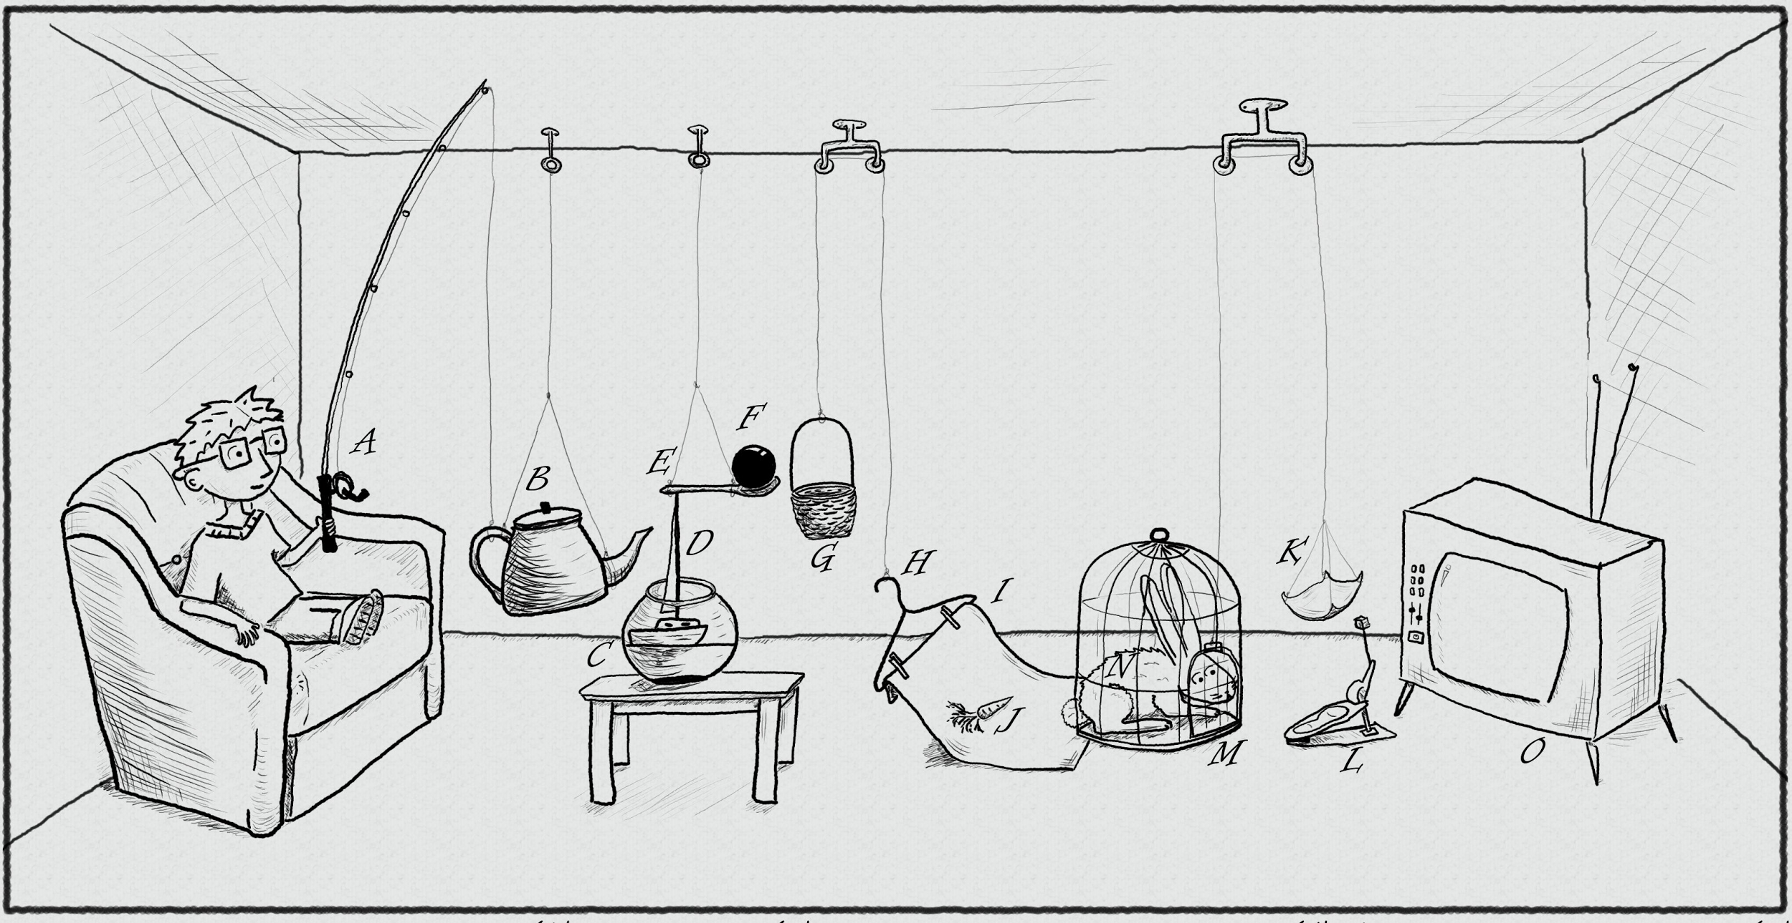
The traditional thread-based concurrency model built into Java doesn’t match well with the natural human sense for parallelism.
https://www.pinterest.com/pin/395190936024778319/

Slide 19

public class MergeSortTask<T extends Comparable<T>> extends RecursiveTask<List<T>> {
@Override
protected List<T> compute() {
if (list.size() < 2) { return list; }
if (list.size() == 2) {
if (list.get(0).compareTo(list.get(1)) != 1) {
return list;
} else {
return asList(list.get(1), list.get(0));
}
}
MergeSortTask<T> leftTask = new MergeSortTask<>(list.subList(0, list.size() / 2));
MergeSortTask<T> rightTask = new MergeSortTask<>(list.subList(list.size() / 2, list.size()));
leftTask.fork(); rightTask.fork();
List<T> left = leftTask.join();
List<T> right = rightTask.join();
return merge(left, right);
}
http://blog.takipi.com/forkjoin-framework-vs-parallel-streams-vs-executorservice-the-ultimate-benchmark/

Slide 20
public class MergeSortTask<T extends Comparable<T>> extends RecursiveTask<List<T>> {
@Override
protected List<T> compute() {
if (list.size() < 2) { return list; }
if (list.size() == 2) {
if (list.get(0).compareTo(list.get(1)) != 1) {
return list;
} else {
return asList(list.get(1), list.get(0));
}
}
MergeSortTask<T> leftTask = new MergeSortTask<>(list.subList(0, list.size() / 2));
MergeSortTask<T> rightTask = new MergeSortTask<>(list.subList(list.size() / 2, list.size()));
leftTask.fork(); rightTask.fork();
List<T> left = leftTask.join();
List<T> right = rightTask.join();
return merge(left, right);
}
http://blog.takipi.com/forkjoin-framework-vs-parallel-streams-vs-executorservice-the-ultimate-benchmark/

Slide 21
public class MergeSortTask<T extends Comparable<T>> extends RecursiveTask<List<T>> {
@Override
protected List<T> compute() {
if (list.size() < 2) { return list; }
if (list.size() == 2) {
if (list.get(0).compareTo(list.get(1)) != 1) {
return list;
} else {
return asList(list.get(1), list.get(0));
}
}
MergeSortTask<T> leftTask = new MergeSortTask<>(list.subList(0, list.size() / 2));
MergeSortTask<T> rightTask = new MergeSortTask<>(list.subList(list.size() / 2, list.size()));
leftTask.fork(); rightTask.fork();
List<T> left = leftTask.join();
List<T> right = rightTask.join();
return merge(left, right);
}
http://blog.takipi.com/forkjoin-framework-vs-parallel-streams-vs-executorservice-the-ultimate-benchmark/

Slide 22
public class MergeSortTask<T extends Comparable<T>> extends RecursiveTask<List<T>> {
@Override
protected List<T> compute() {
if (list.size() < 2) { return list; }
if (list.size() == 2) {
if (list.get(0).compareTo(list.get(1)) != 1) {
return list;
} else {
return asList(list.get(1), list.get(0));
}
}
MergeSortTask<T> leftTask = new MergeSortTask<>(list.subList(0, list.size() / 2));
MergeSortTask<T> rightTask = new MergeSortTask<>(list.subList(list.size() / 2, list.size()));
leftTask.fork(); rightTask.fork();
List<T> left = leftTask.join();
List<T> right = rightTask.join();
return merge(left, right);
}
http://blog.takipi.com/forkjoin-framework-vs-parallel-streams-vs-executorservice-the-ultimate-benchmark/

Slide 23
public class MergeSortTask<T extends Comparable<T>> extends RecursiveTask<List<T>> {
@Override
protected List<T> compute() {
if (list.size() < 2) { return list; }
if (list.size() == 2) {
if (list.get(0).compareTo(list.get(1)) != 1) {
return list;
} else {
return asList(list.get(1), list.get(0));
}
}
MergeSortTask<T> leftTask = new MergeSortTask<>(list.subList(0, list.size() / 2));
MergeSortTask<T> rightTask = new MergeSortTask<>(list.subList(list.size() / 2, list.size()));
leftTask.fork(); rightTask.fork();
List<T> left = leftTask.join();
List<T> right = rightTask.join();
return merge(left, right);
}
http://blog.takipi.com/forkjoin-framework-vs-parallel-streams-vs-executorservice-the-ultimate-benchmark/

Slide 24

.parallel()
Optional<Status> mostPopularTweet = tweets.stream()
.filter(tweet -> tweet.getText().toLowerCase().contains(topic.toLowerCase()))
.filter(tweet -> !tweet.isRetweet())
.max(comparingInt(tweet -> tweet.getFavoriteCount() + tweet.getRetweetCount()));

Slide 25
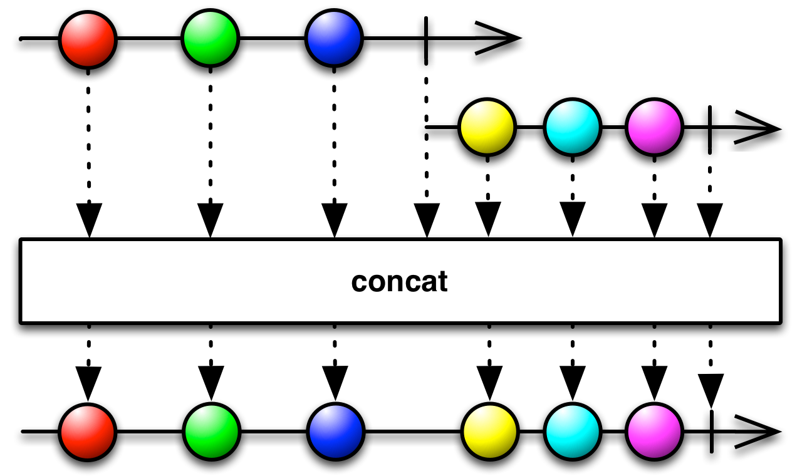
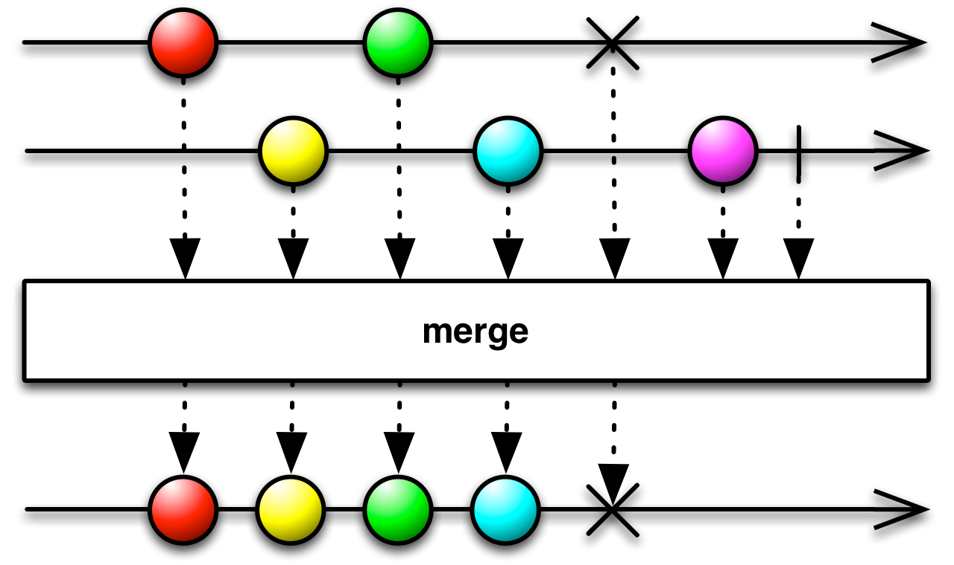
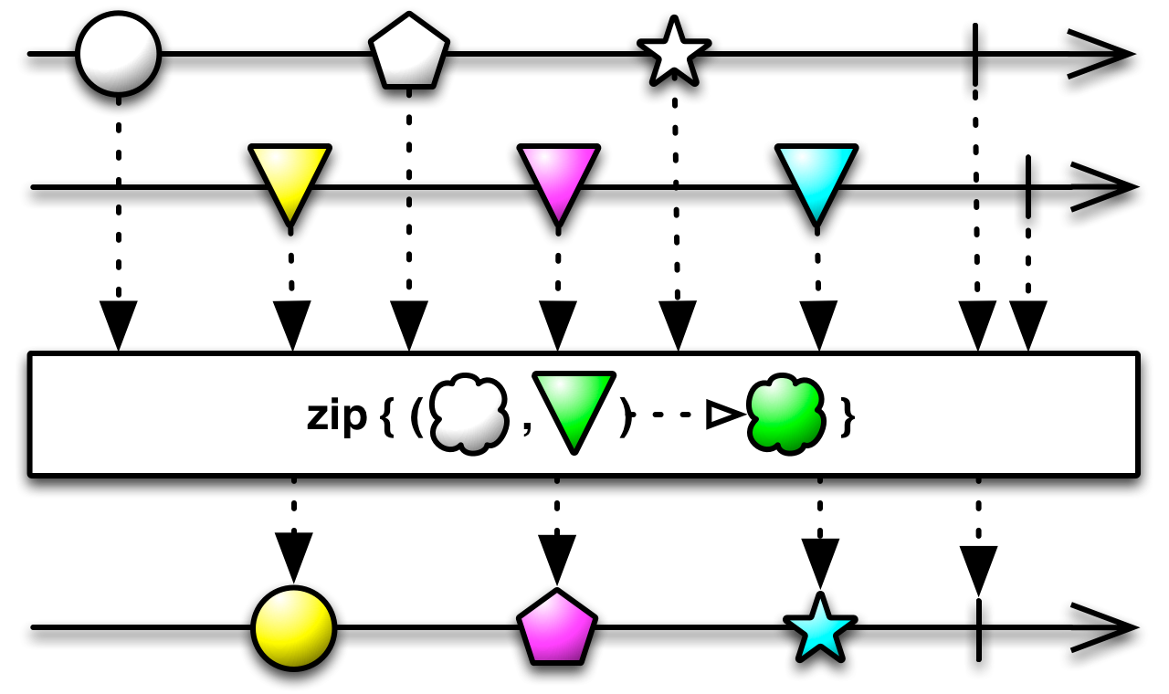
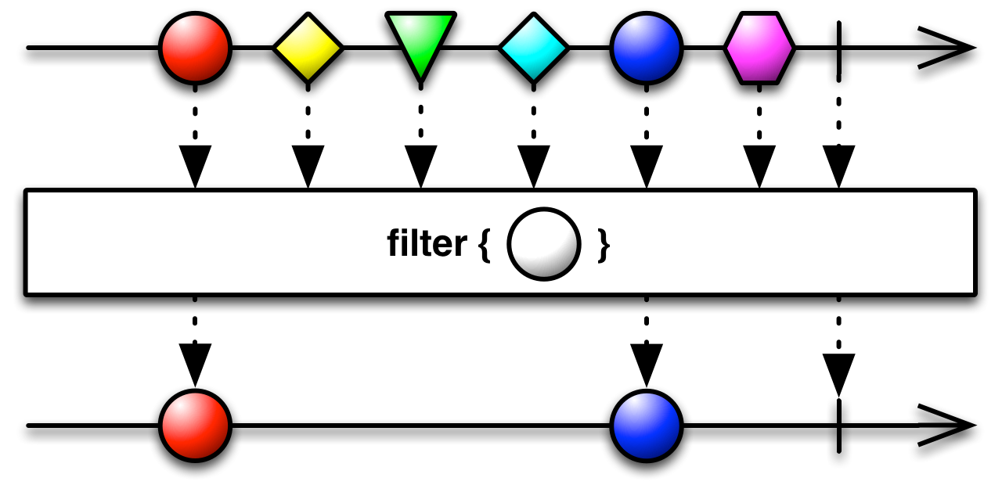
http://reactivex.io/RxJava/2.x/javadoc/io/reactivex/Flowable.html

Slide 26
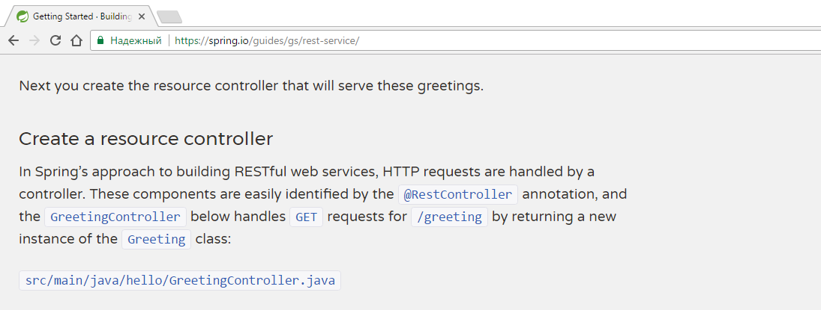
@RestController
public class GreetingController {
private static final String template = "Hello, %s!";
private final AtomicLong counter = new AtomicLong();
@RequestMapping("/greeting")
public Greeting greeting(@RequestParam(value="name", defaultValue="World") String name) {
return new Greeting(counter.incrementAndGet(), String.format(template, name));
}
}

Slide 27
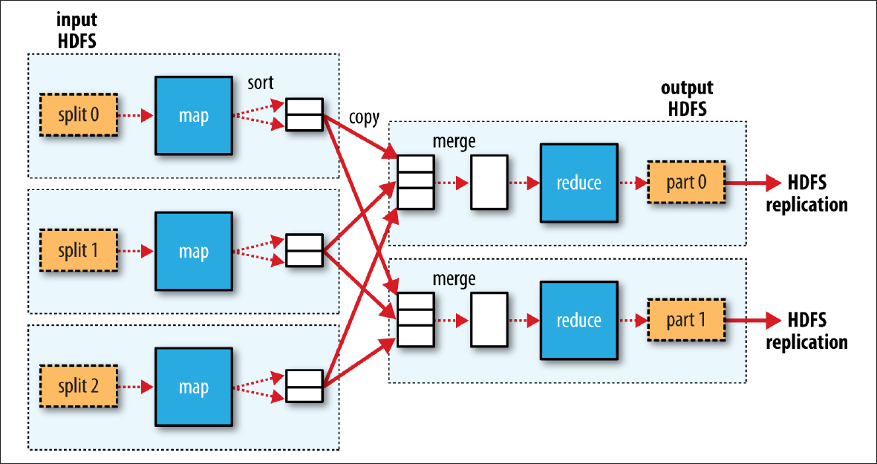

Slide 28



Slide 29
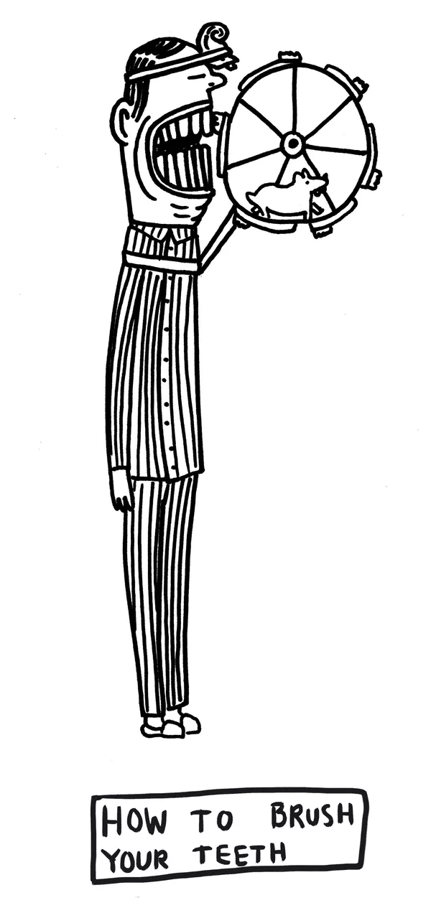
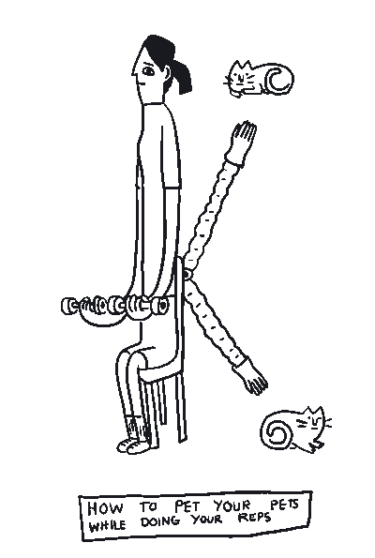

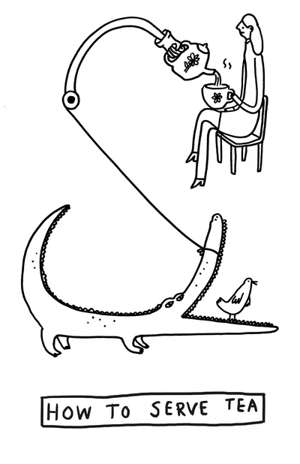
GPars
data parallelism
map/reduce
fork/join
asynchronous execution
actors
agents
dataflows
remote execution
Communicating Sequential Processes
Software Transactional Memory
http://www.theverge.com/2015/4/22/8381963/rube-goldberg-machine-contest-history-ideas

Slide 30
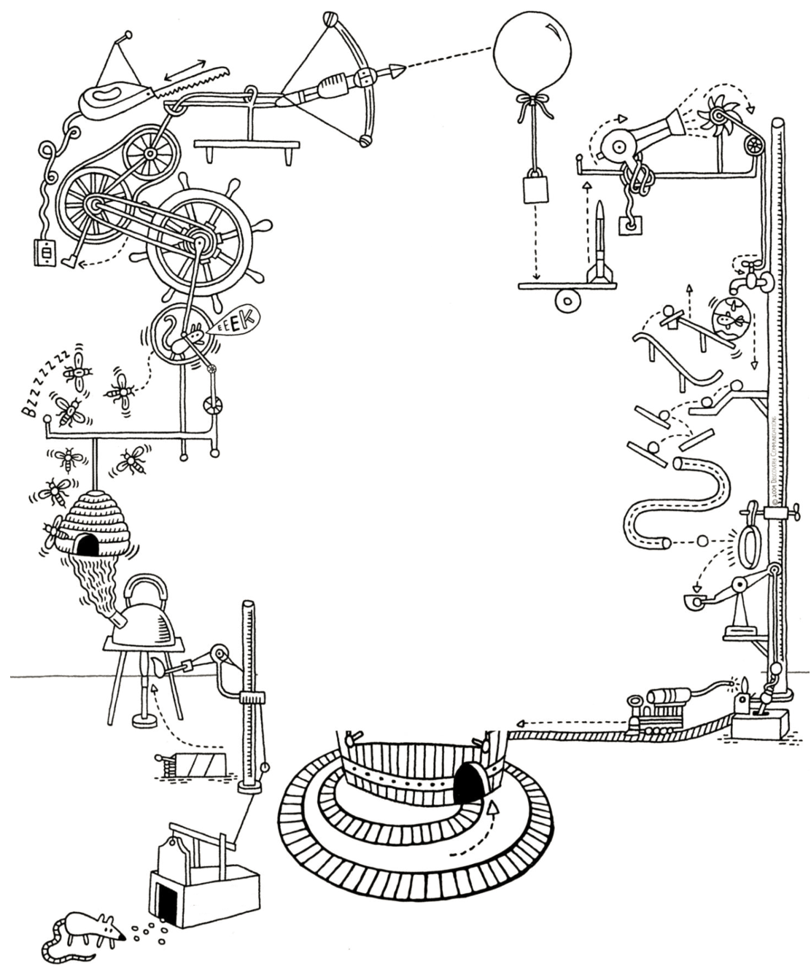
JAVA
OR
GROOVY?
http://forevercuriousmuseum.org/events/rube-goldberg-machine-summer-camp-july-28-29-30-2015/

Slide 31
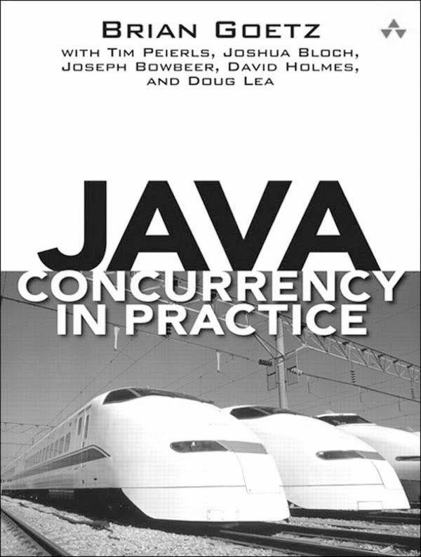
If multiple threads access the same mutable state variable without appropriate synchronization, your program is broken.
There are three ways to fix it:
Don’t share the state variable across threads
Make the state variable immutable
Use synchronization whenever accessing the state variable

Slide 32
public final class ImmutableJavaPerson {
private final String name;
private final Collection<String> tweets;
public ImmutableJavaPerson(String name, Collection<String> tweets) {
this.name = name;
this.tweets = new ArrayList<>(tweets);
}
public String getName() {
return name;
}
public Collection<String> getTweets() {
return unmodifiableCollection(tweets);
}
@Override
public boolean equals(Object o) {
if (this == o) return true;
if (o == null || getClass() != o.getClass()) return false;
ImmutableJavaPerson that = (ImmutableJavaPerson) o;
if (name != null ? !name.equals(that.name) : that.name != null) return false;
return tweets != null ? tweets.equals(that.tweets) : that.tweets == null;
}
@Override
public int hashCode() {
int result = name != null ? name.hashCode() : 0;
result = 31 * result + (tweets != null ? tweets.hashCode() : 0);
return result;
}
}

Slide 33
@Override
public boolean equals(Object o) {
if (this == o) return true;
if (o == null || getClass() != o.getClass()) return false;
ImmutableJavaPerson that = (ImmutableJavaPerson) o;
if (name != null ? !name.equals(that.name) : that.name != null) return false;
return tweets != null ? tweets.equals(that.tweets) : that.tweets == null;
}
@Override
public int hashCode() {
int result = name != null ? name.hashCode() : 0;
result = 31 * result + (tweets != null ? tweets.hashCode() : 0);
return result;
}
}

Slide 34

@Immutable class ImmutableGroovyPerson {
String name
Collection<String> tweets
}

Slide 35

@Immutable class ImmutableGroovyPerson {
String name
Collection<String> tweets
}

Slide 36
class SynchronizedCounter {
int atomicCounter
int counter
@Synchronized
int incrementAndGet() {
atomicCounter = atomicCounter + 1
return atomicCounter
}
@WithReadLock
int value() {
counter
}
@WithWriteLock
void increment() {
counter = counter + 1
}
}

Slide 37
def thread1 = Thread.start {
println "Hello from ${Thread.currentThread().name}"
}
def thread2 = Thread.startDaemon {
println "Hello from ${Thread.currentThread().name}"
}
[ thread1, thread2 ]*.join()

Slide 38
def process = (['git', 'status']).execute([], new File('.'))
def processOutput = new StringWriter()
process.consumeProcessOutput processOutput, processOutput
process.waitFor()
println processOutput.toString().trim()

Slide 39
def config = new CompilerConfiguration()
config.addCompilationCustomizers(new ASTTransformationCustomizer(ThreadInterrupt))
def binding = new Binding(i:0)
def shell = new GroovyShell(binding,config)
def t = Thread.start {
shell.evaluate(userCode)
}
t.join(1000)
if (t.alive) {
t.interrupt()
}
@TimedInterrupt(value=1, unit=TimeUnit.SECONDS)
class FibCalculator {
def fib(int n) {
n < 2 ? n : fib(n - 1) + fib(n - 2)
}
}
@ConditionalInterrupt({ Quotas.disallow('user') })
class UserService {
void longRunningRequest() { ... }
}

Slide 40
"Hello from ${Thread.currentThread().name}"
'''Multi-line
strings'''
def numbers = [ 1, 2, 3 ]
def colors = [ red: '#ff0000', green: '#00ff00', blue: '#0000ff' ]
carNames = car*.name
Clousure sum = { a, b -> a + b }
Clouse increment = sum.curry(1)
name = user?.name
displayName = user.name ?: 'unknown'
assert new String('text') == new String('text')
assert (2 <=> 5) == -1
Object str1 = 'text'
def str2 = str1
assert str1.length() == str2.length()
def sneakyThrow() { throw new IOException("i don't care") }
@IgnoreIf({ os.linux || jdk.version == 8 })

Slide 41
def rows = Sql.newInstance(url, user, password, driver).rows "SELECT * FROM table"
(0..<5).collect { it % 2 == 0 }
println list.find { it > 7 }
if (4 in nums) println 'yes'
println persons.max({ person -> person.age })
5.times { println 'hello!' }
println list[0..2]
def json = new JsonSlurper().parseText(jsonText)
json.clients[3].location.country.code
def xml = new XmlSlurper().parseText(xmlText)
xml.clients[3].location.country.@code
xmlBuilder.root(attribute: 28) {
elem1('hello')
elem2('xml')
}
new File('poem.txt').eachLine { line ->
println line
}
def increment(int number, int delta = 0) { ... }
def connectJdbc(Map params) { ... }
connectJdbc(url: 'jdbc://', driver: 'generic', username: 'admin', password: 'admin')

Slide 42
@Grab(group='org.springframework', module='spring-orm', version='4.3.8.RELEASE')
import org.springframework.jdbc.core.JdbcTemplate
@TypeChecked
@CompileStatic
@Canonical
@InheritConstructors
@Lazy
@Sortable
@Builder
@Delegate
@Memoized
@Singleton
@Log
class MetaProgramming {
def methodMissing(String methodName, def methodArgs) { ... }
}
Number.metaClass.doubleIt = { -> delegate * 2 }
ReturnStatement returnStatement = macro { return "42" }
class MyNumber {
MyNumber plus(MyNumber other) { ... }
}
trait DatabaseTest { ... }
please show the square_root of 100
new GroovyShell(variables).evaluate 'println persons.sort { person -> person.name }'

Slide 43
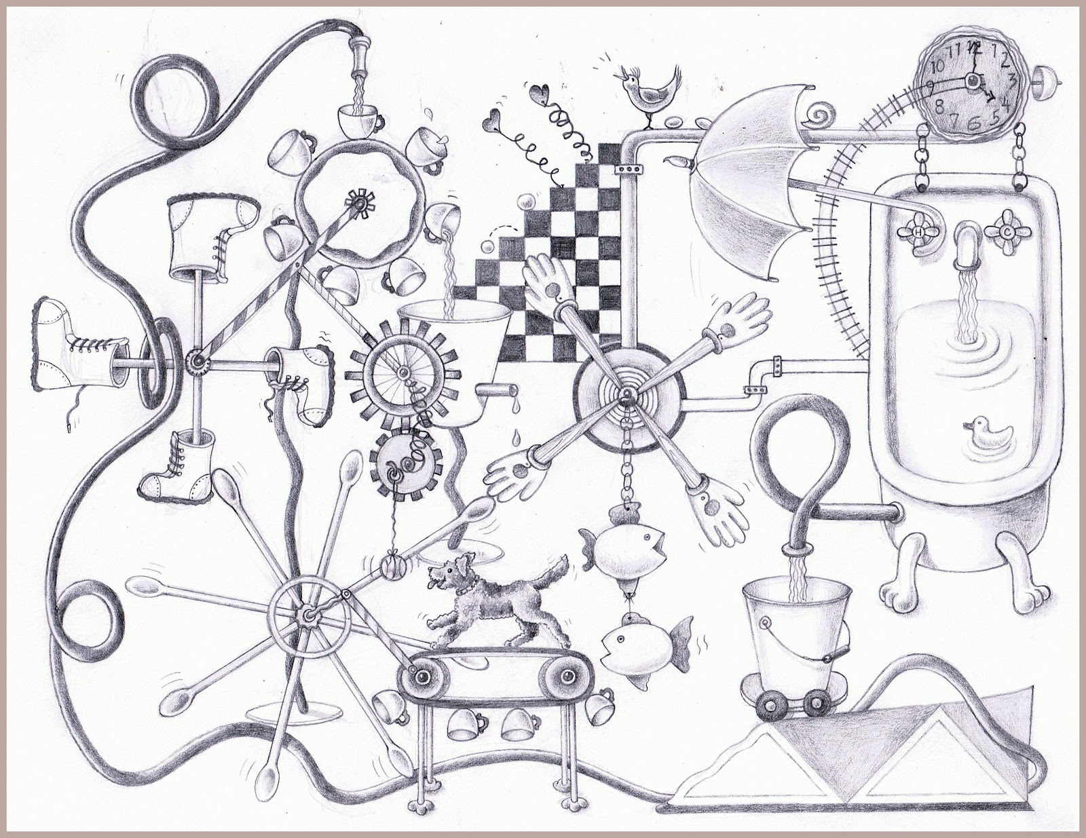
https://www.pinterest.com/pin/527554543837493577/

Slide 44
min

Slide 45
min

Slide 46
min

Slide 47
min

Slide 48
min

Slide 49
min
min
min
min

Slide 50
Optional<Status> mostPopularTweet = tweets.stream()
.parallel()
.filter(tweet -> tweet.getText().toLowerCase().contains(topic.toLowerCase()))
.filter(tweet -> !tweet.isRetweet())
.max(comparingInt(tweet -> tweet.getFavoriteCount() + tweet.getRetweetCount()));

Slide 51
shapes.stream()

Slide 52
Optional<Shape> minBlueCircle = shapes.stream()
.filter(shape -> shape.getType() == CIRCLE)

Slide 53
Optional<Shape> minBlueCircle = shapes.stream()
.filter(shape -> shape.getType() == CIRCLE)
.filter(shape -> shape.getColor() == BLUE)

Slide 54
Optional<Shape> minBlueCircle = shapes.stream()
.filter(shape -> shape.getType() == CIRCLE)
.filter(shape -> shape.getColor() == BLUE)
.min(comparingInt(shape -> shape.getSize()));

Slide 55
min
Optional<Shape> minBlueCircle = shapes.stream()
.parallel()
.filter(shape -> shape.getType() == CIRCLE)
.filter(shape -> shape.getColor() == BLUE)
.min(comparingInt(shape -> shape.getSize()));
.filter(shape -> shape.getType() == CIRCLE)
.filter(shape -> shape.getColor() == BLUE)
.min(comparingInt(shape -> shape.getSize()));

Slide 56
shapes

Slide 57
Shape minBlueCircle = shapes
.findAll({ shape -> shape.type == CIRCLE })

Slide 58
Shape minBlueCircle = shapes
.findAll({ shape -> shape.type == CIRCLE })
.findAll({ shape -> shape.color == BLUE })

Slide 59
Shape minBlueCircle = shapes
.findAll({ shape -> shape.type == CIRCLE })
.findAll({ shape -> shape.color == BLUE })
.min({ shape -> shape.size })

Slide 60
ParallelEnhancer.enhanceInstance shapes
Shape minBlueCircle = shapes
.findAllParallel({ shape -> shape.type == CIRCLE })
.findAllParallel({ shape -> shape.color == BLUE })
.minParallel({ shape -> shape.size })

Slide 61
min
ParallelEnhancer.enhanceInstance shapes
shapes.makeConcurrent()
Shape minBlueCircle = shapes
.findAll({ shape -> shape.type == CIRCLE })
.findAll({ shape -> shape.color == BLUE })
.min({ shape -> shape.size })
.findAll({ shape ->
shape.type == CIRCLE
})

Slide 62
min
ParallelEnhancer.enhanceInstance shapes
shapes.makeConcurrent()
Shape minBlueCircle = shapes
.findAll({ shape -> shape.type == CIRCLE })
.findAll({ shape -> shape.color == BLUE })
.min({ shape -> shape.size })
.findAll({ shape ->
shape.color == BLUE
})

Slide 63
min
ParallelEnhancer.enhanceInstance shapes
shapes.makeConcurrent()
Shape minBlueCircle = shapes
.findAll({ shape -> shape.type == CIRCLE })
.findAll({ shape -> shape.color == BLUE })
.min({ shape -> shape.size })
.min({ shape -> shape.size
})

Slide 64
Shape minBlueCircle = shapes
.findAll({ shape -> shape.type == CIRCLE })
.findAll({ shape -> shape.color == BLUE })
.min({ shape -> shape.size })

Slide 65
min
withPool {
Shape minBlueCircle = shapes.parallel
.filter({ shape -> shape.type == CIRCLE })
.filter({ shape -> shape.color == BLUE })
.min({ shape -> shape.size })
}
.filter({ shape -> shape.type == CIRCLE })
.filter({ shape -> shape.color == BLUE })
.min({ shape -> shape.size })

Slide 66
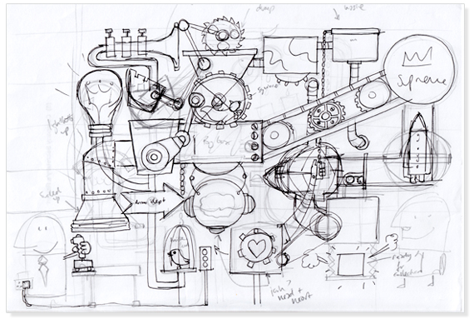
withPool
https://discoveryartjoy.wordpress.com/page/2/

Slide 67
withPool {
}

Slide 68
GParsPool.withPool {
}

Slide 69
GParsPool.withPool { ForkJoinPool pool ->
}

Slide 70
GParsPool.withExistingPool(pool) {
}

Slide 71
GParsExecutorsPool.withPool { ExecutorService executor ->
}

Slide 72
GParsPool.withPool { ForkJoinPool pool ->
}

Slide 73
GParsPool.withPool(numberOfThreads, exceptionHandler) { ForkJoinPool pool ->
}
Runtime.getRuntime().availableProcessors() + 1

Slide 74
withPool {
}
Shape minBlueCircle = shapes
.findAllParallel({ shape -> shape.type == CIRCLE })
.findAllParallel({ shape -> shape.color == BLUE })
.minParallel({ shape -> shape.size })
shapes.makeConcurrent()
Shape minBlueCircle = shapes
.findAll({ shape -> shape.type == CIRCLE })
.findAll({ shape -> shape.color == BLUE })
.min({ shape -> shape.size })
Shape minBlueCircle = shapes.parallel
.filter({ shape -> shape.type == CIRCLE })
.filter({ shape -> shape.color == BLUE })
.min({ shape -> shape.size })

Slide 75
withPool {
}

Slide 76
withPool {
List latestTweets = twitter.fetchLatestTweets()
println 'Done:'
println latestTweets
}

Slide 77
withPool {
Future latestTweets = executeAsync({ twitter.fetchLatestTweets() })
println 'Loading...'
println latestTweets.get()
}

Slide 78
withPool {
Future latestTweets = twitter.&fetchLatestTweets.callAsync()
println 'Loading...'
println latestTweets.get()
}

Slide 79
withPool {
Closure fetchLatestTweetsAsync = twitter.&fetchLatestTweets.async()
Future latestTweets = fetchLatestTweetsAsync()
println 'Loading...'
println latestTweets.get()
}

Slide 80
withPool {
Closure fetchLatestTweetsAsync = twitter.&fetchLatestTweets.async()
Future latestTweets = fetchLatestTweetsAsync()
Closure extractKeywordsAsync = keywords.&extractKeywords.async()
println 'Loading tweets...'
Future keywords = extractKeywordsAsync(latestTweets.get())
println 'Extracting keywords...'
println keywords.get()
}

Slide 81
withPool {
Closure fetchLatestTweetsAsync = twitter.&fetchLatestTweets.asyncFun()
Promise latestTweets = fetchLatestTweetsAsync()
Closure extractKeywordsAsync = keywords.&extractKeywords.asyncFun()
Promise keywords = extractKeywordsAsync(latestTweets)
println 'Loading tweets and extracting keywords...'
println keywords.get()
}

Slide 82
withPool {
Closure fetchLatestTweetsAsync = twitter.&fetchLatestTweets.asyncFun()
Promise latestTweets = fetchLatestTweetsAsync()
Closure extractKeywordsAsync = keywords.&extractKeywords.asyncFun()
Promise keywords = extractKeywordsAsync(latestTweets)
keywords.whenBound {
println it
}
println 'Loading tweets and extracting keywords...'
}

Slide 83
withPool {
Closure fetchAsync = twitter.&fetchLatestTweets.asyncFun()
Closure watsonsExtractKeywords = watsons.&extractKeywords.curry(fetchAsync())
Closure googleExtractKeywords = google.&extractKeywords.curry(fetchAsync())
List keywords = watsonsExtractKeywords()
println keywords
}

Slide 84
withPool {
Closure fetchAsync = twitter.&fetchLatestTweets.asyncFun()
Closure watsonsExtractKeywords = watsons.&extractKeywords.curry(fetchAsync())
Closure googleExtractKeywords = google.&extractKeywords.curry(fetchAsync())
List keywords = googleExtractKeywords()
println keywords
}

Slide 85
withPool {
Closure fetchAsync = twitter.&fetchLatestTweets.asyncFun()
Closure watsonsExtractKeywords = watsons.&extractKeywords.curry(fetchAsync())
Closure googleExtractKeywords = google.&extractKeywords.curry(fetchAsync())
List keywords = speculate( watsonsExtractKeywords(), googleExtractKeywords() )
println keywords
}

Slide 86
withPool {
Closure fetchAsync = twitter.&fetchLatestTweets.asyncFun()
Closure watsonsExtractKeywords = watsons.&extractKeywords.curry(fetchAsync())
Closure googleExtractKeywords = google.&extractKeywords.curry(fetchAsync())
List keywords = speculate( watsonsExtractKeywords(), googleExtractKeywords() )
println keywords
}

Slide 87
withPool {
List latestTweets = twitter.fetchLatestTweets()
Closure watsonsExtractKeywords = watsons.&extractKeywords.curry(latestTweets)
Closure googleExtractKeywords = google.&extractKeywords.curry(latestTweets)
List keywords = speculate( watsonsExtractKeywords(), googleExtractKeywords() )
println keywords
}

Slide 88
withPool {
Closure fetchWithCache = twitter.&fetchLatestTweets.gmemoize()
Closure watsonsExtractKeywords = watsons.&extractKeywords.curry(fetchWithCache())
Closure googleExtractKeywords = google.&extractKeywords.curry(fetchWithCache())
List keywords = speculate( watsonsExtractKeywords(), googleExtractKeywords() )
println keywords
}

Slide 89
withPool {
runForkJoin(list) { list ->
if (list.size() < 2) { return list }
if (list.size() == 2) {
if (list[0] <= list[1]) {
return list
} else {
return list[-1..0]
}
}
int middleIndex = list.size() / 2
forkOffChild list[0..<middleIndex]
forkOffChild list[middleIndex..<list.size()]
return merge(*childrenResults)
}
}

Slide 90


Slide 91
withPool(lambdaToClosure(() -> {
}));

Slide 92
withPool(lambdaToClosure(() -> {
Future result = executeAsync (
lambdaToClosure(() -> { return twitter.fetchLatestTweets(); })
).get(0);
final List tweets = (List) result.get();
List keywords = speculate (
lambdaToClosure(() -> { return watsons.extractKeywords(tweets); }),
lambdaToClosure(() -> { return google.extractKeywords(tweets); })
);
return keywords;
}));

Slide 93
withPool(lambdaToClosure(() -> {
Future result = executeAsync (
lambdaToClosure(() -> { return twitter.fetchLatestTweets(); })
).get(0);
final List tweets = (List) result.get();
List keywords = speculate (
lambdaToClosure(() -> { return watsons.extractKeywords(tweets); }),
lambdaToClosure(() -> { return google.extractKeywords(tweets); })
);
return keywords;
}));

Slide 94
withPool {
Shape minBlueCircle = shapes
.findAllParallel({ shape -> shape.type == CIRCLE })
.findAllParallel({ shape -> shape.color == BLUE })
.minParallel({ shape -> shape.size })
}

Slide 95
withPool {
List<Shape> blueCircles = []
shapes.findAllParallel({ shape -> shape.type == CIRCLE })
.findAllParallel({ shape -> shape.color == BLUE })
.eachParallel({ shape -> blueCircles.add(shape) })
}
If multiple threads access the same mutable state variable without appropriate synchronization, your program is broken.

Slide 96
Thread #1
Thread #2
synchronized
blueCircles.add(shape)
blueCircles.add(shape)
blueCircles.add(shape)
blueCircles.add(shape)
blueCircles.add(shape)
blueCircles.add(shape)

Slide 97
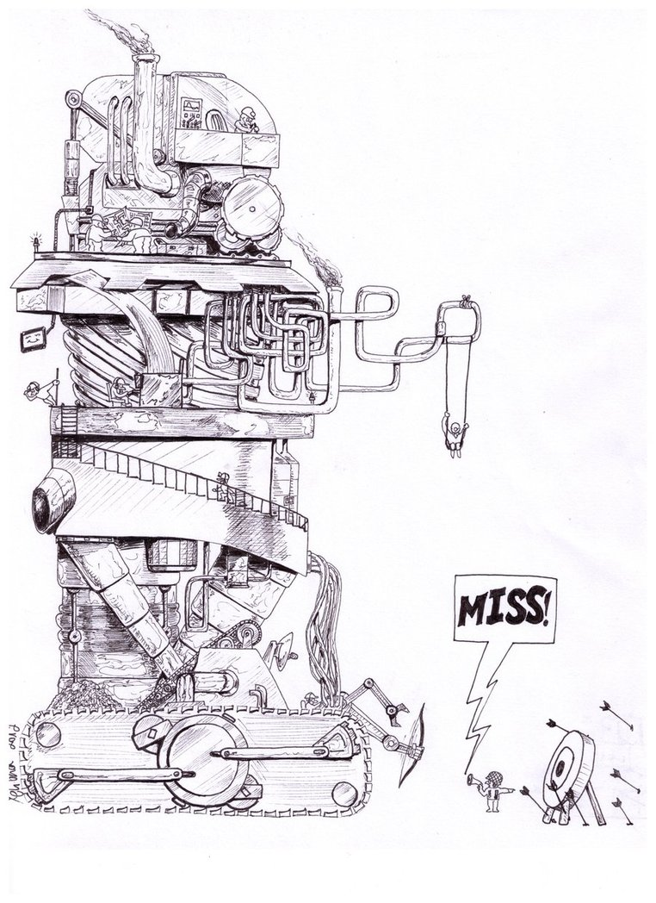
AGENTS
http://www.keywordsuggests.com/DT5zG9YMrnEK707aqUa2IhkNs5vUwu3mV6WrrLHR0soHddyR42EFvbEkYg9kaqswD%7CyremGnEFLO%7CzJXdp0SMQ/

Slide 98
withPool {
def blueShapesGuard = new Agent<List<Shape>>()
blueShapesGuard { updateValue [] }
shapes.findAllParallel({ shape -> shape.type == CIRCLE })
.findAllParallel({ shape -> shape.color == BLUE })
.eachParallel({ shape -> blueShapesGuard { it.add(shape) } })
}

Slide 99
Thread #1
Thread #2
Agent
blueCircles.add(shape)
blueCircles.add(shape)
blueCircles.add(shape)
blueCircles.add(shape)
blueCircles.add(shape)
blueCircles.add(shape)

Slide 100
withPool {
def blueShapesGuard = new Agent<Shape>()
blueShapesGuard { updateValue [] }
shapes.findAllParallel({ shape -> shape.type == CIRCLE })
.findAllParallel({ shape -> shape.color == BLUE })
.eachParallel({ shape -> blueShapesGuard { it.add(shape) } })
}
blueShapesGuard.addListener { oldValue, newValue -> … }
blueShapesGuard.addValidator { oldValue, newValue -> … }
println blueShapesGuard.val
blueShapesGuard.valAsync { println it }

Slide 102
final Agent<List<Shape>> blueShapesGuard = new Agent<>();
blueShapesGuard.send(new ArrayList<>());
blueShapesGuard.send(new MessagingRunnable<List<Shape>>() {
@Override
protected void doRun(List<Shape> value) {
value.add(shape);
}
});
blueShapesGuard.valAsync(new MessagingRunnable<List<Shape>>() {
@Override
protected void doRun(List<Shape> value) {
System.out.println(value);
}
});

Slide 103

Thread #1
Thread #2
Agent
blueCircles.add(shape)
blueCircles.add(shape)
blueCircles.add(shape)
blueCircles.add(shape)
blueCircles.add(shape)
blueCircles.add(shape)

Slide 104

Thread #1
Thread #2
Actor
message
message
message
message
message
message

Slide 105
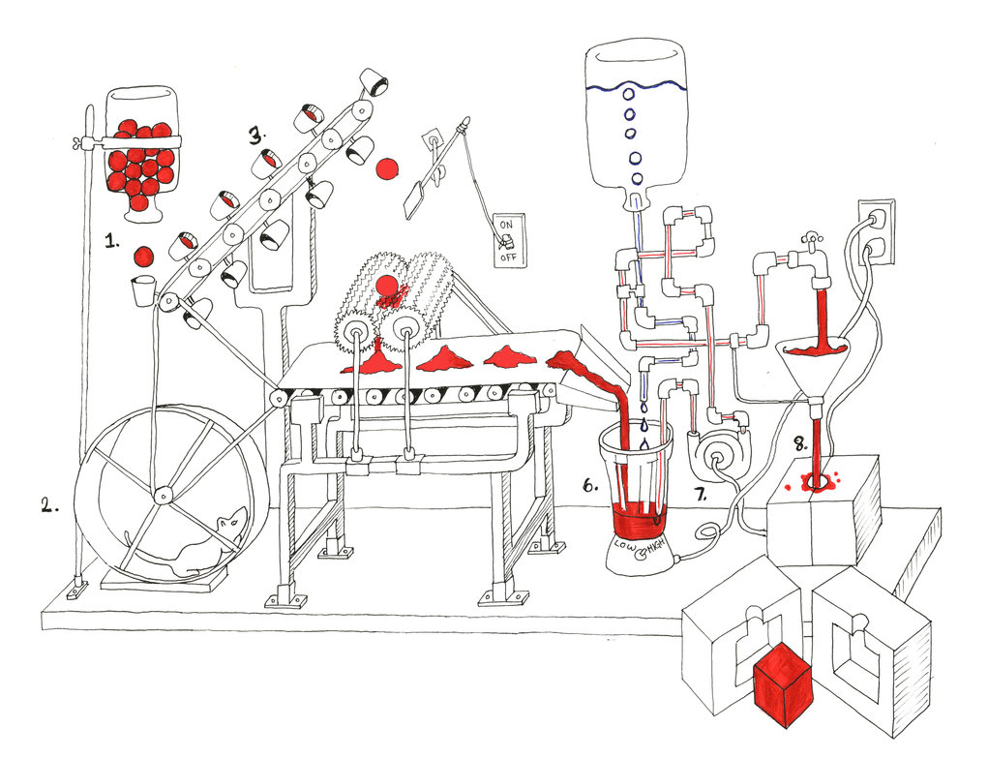
ACTORS
http://tommyboy5000.deviantart.com/art/Rube-Goldberg-machine-485199926

Slide 106
class ShapesGuardActor extends DefaultActor {
List<Shape> shapes
void afterStart() {
shapes = []
}
void act() {
loop {
react { def shape -> shapes.add shape }
}
}
}

Slide 107
class ShapesGuardActor extends DefaultActor {
List<Shape> shapes
void afterStart() {
shapes = []
}
void act() {
loop {
react { def shape -> shapes.add shape }
}
}
}
executed for received message
message

Slide 108
class ShapesGuardActor extends DefaultActor {
List<Shape> shapes
void afterStart() {
shapes = []
}
void act() {
loop {
react { def shape -> shapes.add shape }
}
}
}
continuously receive messages, one thread at most

Slide 109
class KeywordStoreActor extends DefaultActor {
KeywordsRepository keywordsRepository
void act() {
loop {
react { def keyword -> keywordsRepository.store keyword }
}
}
}

Slide 110
def keywordStoreActor = actor {
loop {
react { def keyword ->
keywordsRepository.store keyword
}
}
}

Slide 111
def keywordStoreActor = actor {
loop {
react { def keyword ->
keywordsRepository.store id, keyword
}
}
}

Slide 112
def keywordStoreActor = actor {
loop {
react { def keyword ->
idGenerator << keyword
react { Id id ->
keywordsRepository.store id, keyword
}
}
}
}
send message
process answer
def idGenerator = actor {
loop {
react { def keyword ->
Id id = ...
keyword.reply id
}
}
}
reply to sender

Slide 113
def keywordStoreActor = actor {
loop {
react { def keyword ->
idGenerator << keyword
react { Id id ->
keywordsRepository.store id, keyword
}
}
}
}
def idGenerator = reactor { def keyword ->
Id id = ...
keyword.reply id
}

Slide 115
Closure keywordStoreHandler = new ReactorMessagingRunnable<Keyword, Object>() {
@Override protected Object doRun(final Keyword keyword) {
idGenerator.sendAndContinue(keyword, new MessagingRunnable<Id>() {
@Override protected void doRun(final Id id) {
keywordsRepository.store(id, keyword);
}
});
return null;
}
};
Actor keywordStoreActor = new ReactiveActor(keywordStoreHandler);
Closure idGeneratorHandler = new ReactorMessagingRunnable<Keyword, Id>() {
@Override protected Id doRun(Keyword argument) {
Id id = ...
return id;
}
};
Actor idGenerator = new ReactiveActor(idGeneratorHandler);

Slide 116
def keywordStoreActor = actor {
loop {
react { def keyword ->
idGenerator << keyword
react { Id id ->
keywordsRepository.store id, keyword
}
}
}
}
def idGenerator = reactor { def keyword ->
Id id = ...
keyword.reply id
}

Slide 117
def keywordStoreActor = actor {
loop {
react { def keyword ->
idGenerator << keyword
react { Id id ->
keywordsRepository.store id, keyword
}
}
}
}
def idGenerator = reactor { def message ->
if (message instanceof Keyword) {
id = ...
}
if (message instanceof Tweet) {
id = ...
}
message.reply id
}

Slide 118
def keywordStoreActor = actor {
loop {
react { def keyword ->
idGenerator << keyword
react { Id id ->
keywordsRepository.store id, keyword
}
}
}
}
def idGenerator = reactor { def message ->
if (message instanceof Keyword) {
id = ...
}
if (message instanceof Tweet) {
id = ...
}
if (message instanceof FacebookPost) {
id = ...
}

Slide 119
def keywordStoreActor = actor {
loop {
react { def keyword ->
idGenerator << keyword
react { Id id ->
keywordsRepository.store id, keyword
}
}
}
}
def idGenerator = messageHandler {
when { Keyword keyword -> reply generateKeywordId(keyword) }
when { Tweet tweet -> reply generateTweetId(tweet) }
when { FacebookPost facebookPost -> reply generateFacebookPostId(facebookPost) }
}

Slide 121
Closure keywordStoreHandler = new ReactorMessagingRunnable<Keyword, Object>() {
@Override protected Object doRun(final Keyword keyword) {
idGenerator.sendAndContinue(keyword, new MessagingRunnable<Id>() {
@Override protected void doRun(final Id id) {
keywordsRepository.store(id, keyword);
}
});
return null;
}
};
Actor keywordStoreActor = new ReactiveActor(keywordStoreHandler);
Actor idGenerator = new DynamicDispatchActor() {
public void onMessage(final Keyword keyword) {
replyIfExists(generateKeywordId(keyword));
}
public void onMessage(final Tweet tweet) {
replyIfExists(generateTweetId(tweet));
}

Slide 122
def keywordStoreActor = actor {
loop {
react { def keyword ->
idGenerator << keyword
react { Id id ->
keywordsRepository.store id, keyword
}
}
}
}
def idGenerator = reactor { def keyword ->
Id id = generateId(keyword)
keyword.reply id
}

Slide 123
def keywordStoreActor = actor {
loop {
react { def keyword ->
idGenerator << keyword
react { Id id ->
keywordsRepository.store id, keyword
}
}
}
}
def idGenerator = reactor { def keyword ->
Id id = generateId(keyword)
keyword.reply id
}

Slide 124
def keywordStoreActor = actor {
loop {
react { def keyword ->
idGenerator << keyword
react { Id id ->
keywordsRepository.store id, keyword
}
}
}
}
def idGenerator = reactor { def keyword ->
Id id = generateId(keyword)
keyword.reply id
}

Slide 125
keywordStoreActor
keyword
idGenerator
id

Slide 126
keywordStoreTask
idGeneratorTask
get
keyword
get
id
get
keyword
set
id

Slide 127
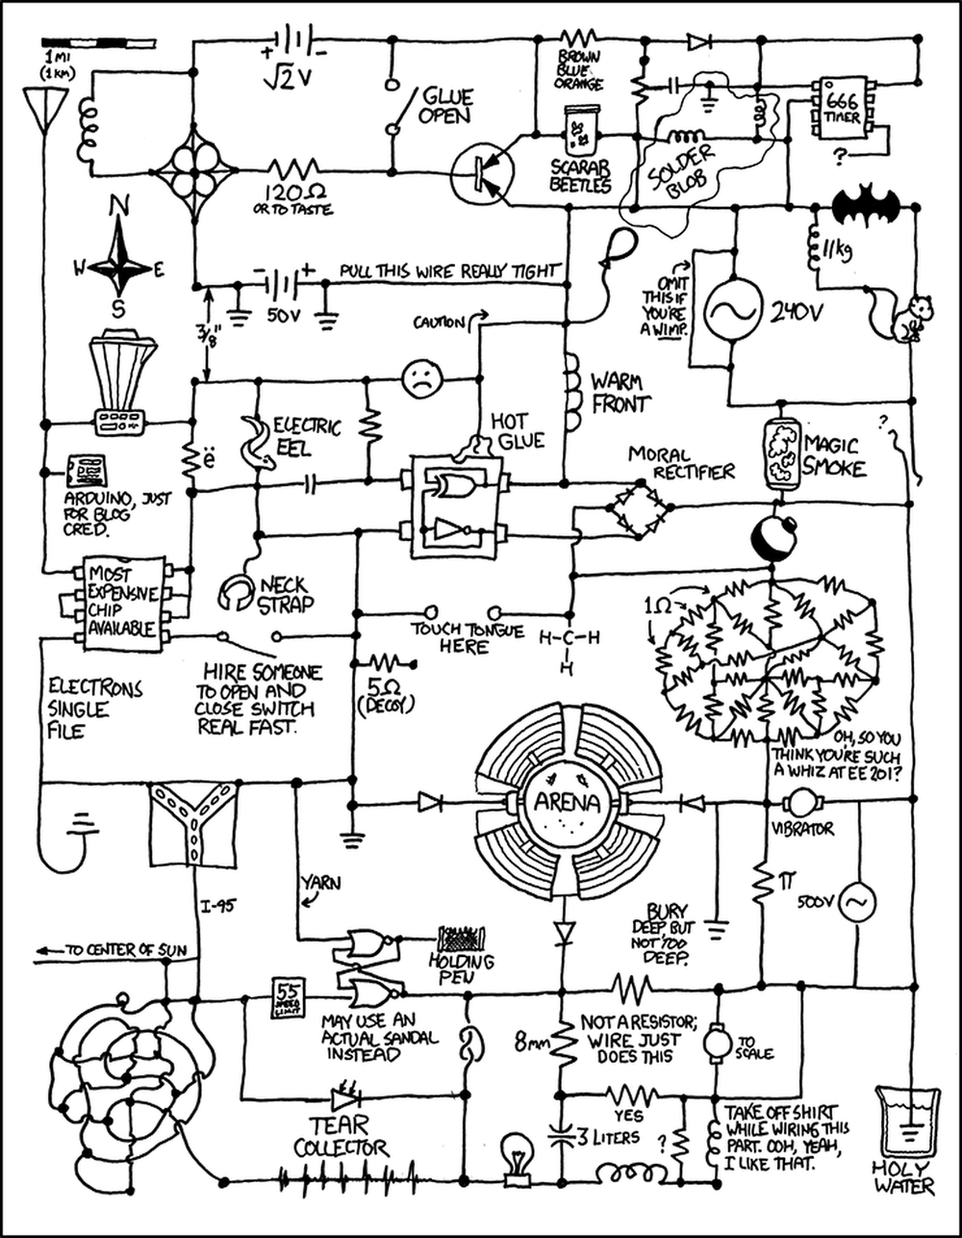
DATAFLOWS
http://www.projectroomseattle.org/programs-content/2014/6/preparing-for-the-failure-variety-show-the-rube-goldberg-confessionals

Slide 128
final def keyword = new DataflowVariable()
final def id = new DataflowVariable()
created
created

Slide 129
final def keyword = new DataflowVariable()
final def id = new DataflowVariable()
created
created
task {
keywordsRepository.store id, keyword
}
started asynchronously
blocked because id and keyword are not bound

Slide 130
final def keyword = new DataflowVariable()
final def id = new DataflowVariable()
created
created
task {
keywordsRepository.store id, keyword
}
blocked because id and keyword are not bound
task {
id = generateId(keyword)
}
blocked because keyword is not bound

Slide 131
final def keyword = new DataflowVariable()
final def id = new DataflowVariable()
created
created
task {
keywordsRepository.store id, keyword
}
blocked because id and keyword are not bound
task {
id = generateId(keyword)
}
blocked because keyword is not bound
task {
List keywords = keywordsService.extractKeywords()
keyword = orderByPriority(keywords)[0]
}
bind keyword

Slide 132
final def keyword = new DataflowVariable()
final def id = new DataflowVariable()
bound
created
task {
keywordsRepository.store id, keyword
}
blocked because id is not bound
task {
id = generateId(keyword)
}
bind id
task {
List keywords = keywordsService.extractKeywords()
keyword = orderByPriority(keywords)[0]
}

Slide 133
final def keyword = new DataflowVariable()
final def id = new DataflowVariable()
bound
bound
task {
keywordsRepository.store id, keyword
}
done
task {
id = generateId(keyword)
}
task {
List keywords = keywordsService.extractKeywords()
keyword = orderByPriority(keywords)[0]
}

Slide 135
final DataflowVariable<Keyword> keyword = new DataflowVariable<>();
final DataflowVariable<Id> id = new DataflowVariable<>();
task(lambdaToClosure(() -> {
keywordsRepository.store(id.getVal(), keyword.getVal());
}));
task(lambdaToClosure(() -> {
id.bind(generateId(keyword.getVal()));
}));
task(lambdaToClosure(() -> {
List<Keyword> keywords = keywordsService.extractKeywords();
keyword.bind(orderByPriority(keywords).get(0));
}));

Slide 136
final def keyword = new DataflowVariable()
final def id = new DataflowVariable()
task {
keywordsRepository.store id, keyword
}
task {
id = generateId(keyword)
}
task {
List keywords = keywordsService.extractKeywords()
keyword = orderByPriority(keywords)[0]
}
started asynchronously
blocked because id and keyword are not bound

Slide 137
final def keyword = new DataflowVariable()
final def id = new DataflowVariable()
whenAllBound(keyword, id) {
keywordsRepository.store id, keyword
}
task {
id = generateId(keyword)
}
task {
List keywords = keywordsService.extractKeywords()
keyword = orderByPriority(keywords)[0]
}
blocked until all mentioned variables are bound

Slide 138
final def keywords = new DataflowVariable()
task {
def keyword = orderByPriority(keywords)[0]
keywordsRepository.store keyword
}
task {
keywords = keywordsService.extractKeywords()
}

Slide 139
final def keywords = new DataflowVariable()
keywords.whenBound {
def keyword = orderByPriority(keywords)[0]
keywordsRepository.store keyword
}
task {
keywords = keywordsService.extractKeywords()
}

Slide 140
task {
keywordsService.extractKeywords()
}.whenBound {
def keyword = orderByPriority(keywords)[0]
keywordsRepository.store keyword
}

Slide 141
task {
keywordsService.extractKeywords()
}.whenBound {
Promise orderedKeywords = orderByPriorityAsync(keywords)
orderedKeywords.whenBound {
keywordsRepository.store orderedKeywords[0]
}
}

Slide 142
task {
keywordsService.extractKeywords()
}.then orderByPriority
then { it[0] }
then keywordsRepository.&store

Slide 143
task {
keywordsService.extractKeywords()
}.then priorityOrderActor.&sendAndPromise then { it[0] } then repositoryStoreActor.&sendAndPromise

Slide 144
final def keywords = new DataflowQueue()
task {
while (true) { keywordsRepository.store keywords.val }
}
blocked until new value is binded
task {
keywordsService.extractKeywords().each { keyword ->
keywords << keyword
}
}
bind new value

Slide 145
final def keywords = new DataflowQueue()
task {
while (true) { keywordsRepository.store keywords.val }
}
task {
withPool {
List allKeywords = keywordsService.extractKeywords()
allKeywords.findAllParallel({!spamService.isSpam(it)}).each { keyword ->
keywords << keyword
}
}
}

Slide 146
final def keywords = new DataflowQueue()
keywords.wheneverBound {
keywordsRepository.store it
}
started each time value is binded
task {
keywordsService.extractKeywords().each { keyword ->
keywords << keyword
}
}

Slide 147
final def keywords = new DataflowQueue()
task {
while (true) { keywordsRepository.store keywords.val }
}
task {
keywordsService.extractKeywords().each { keyword ->
keywords << keyword
}
}
task {
while (true) { logService.debug keywords.val }
}

Slide 148
final def keywordsBroadcast = new DataflowBroadcast()
final def keywordsRepositoryChannel = keywordsBroadcast.createReadChannel()
final def keywordsLogChannel = keywordsBroadcast.createReadChannel()
task {
while (true) { keywordsRepository.store keywordsRepositoryChannel.val }
}
task {
keywordsService.extractKeywords().each { keyword ->
keywordsBroadcast << keyword
}
}
task {
while (true) { logService.debug keywordsLogChannel.val }
}

Slide 149
final def keywords = new DataflowQueue()
splitter (keywords, [ keywordsForStoring, keywordsForLogging ])
operator (inputs: [ keywordsForStoring ], outputs: []) { keywordForStoring ->
keywordsRepository.store keywordForStoring
}
task {
keywordsService.extractKeywords().each { keyword ->
keywords << keyword
}
}
operator (inputs: [ keywordsForLogging ], outputs: []) { keywordsForLogging ->
logService.debug keywordsForLogging
}

Slide 150
final def keywords = new DataflowQueue()
splitter (keywords, [ keywordsForStoring, keywordsForLogging ])
operator (inputs: [ keywordsForStoring ], outputs: [], stateObject: [id: 0]) {
keywordForStoring -> keywordsRepository.store id++, keywordForStoring
}
task {
keywordsService.extractKeywords().each { keyword ->
keywords << keyword
}
}
operator (inputs: [ keywordsForLogging ], outputs: []) { keywordsForLogging ->
logService.debug keywordsForLogging
}

Slide 151
final def keywords = new DataflowQueue()
splitter (keywords, [ keywordsForStoring, keywordsForLogging ])
operator (inputs: [ id, keywordsWithId ], outputs: []) { id, keywordsWithId ->
keywordsRepository.store id, keywordForStoring
}
task {
keywordsService.extractKeywords().each { keyword ->
keywords << keyword
}
}
operator (inputs: [ keywordsForId ], outputs: [ id, keywordsWithId ]) { keyword ->
bindAllOutputValues generateId(keyword), keyword
}
operator (inputs: [ keywordsForLogging ], outputs: []) { keywordsForLogging ->
logService.debug keywordsForLogging
}
o

Slide 152
splitter (keywords, [ keywordsForStoring, keywordsForLogging ])
operator (inputs: [ id, keywordsWithId ], outputs: []) { id, keywordsWithId ->
keywordsRepository.store id, keywordForStoring
}
selector (inputs: [ fromWatsons, fromGoogle ], outputs: [ keyword ]) { keywords ->
keywords.each {
bindOutput 0, it
}
}
operator (inputs: [ keywordsForId ], outputs: [ id, keywordsWithId ]) { keyword ->
bindAllOutputValues generateId(keyword), keyword
}
operator (inputs: [ keywordsForLogging ], outputs: []) { keywordsForLogging ->
logService.debug keywordsForLogging
}
o

Slide 153
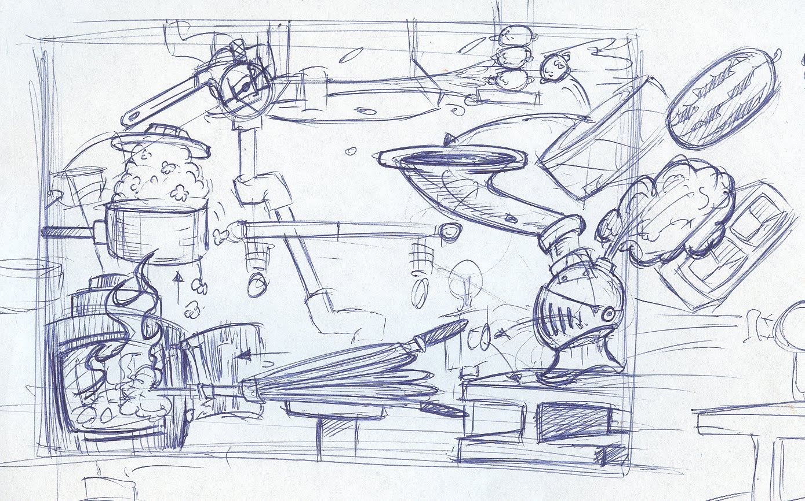
LESSONS LEARNED

Slide 154
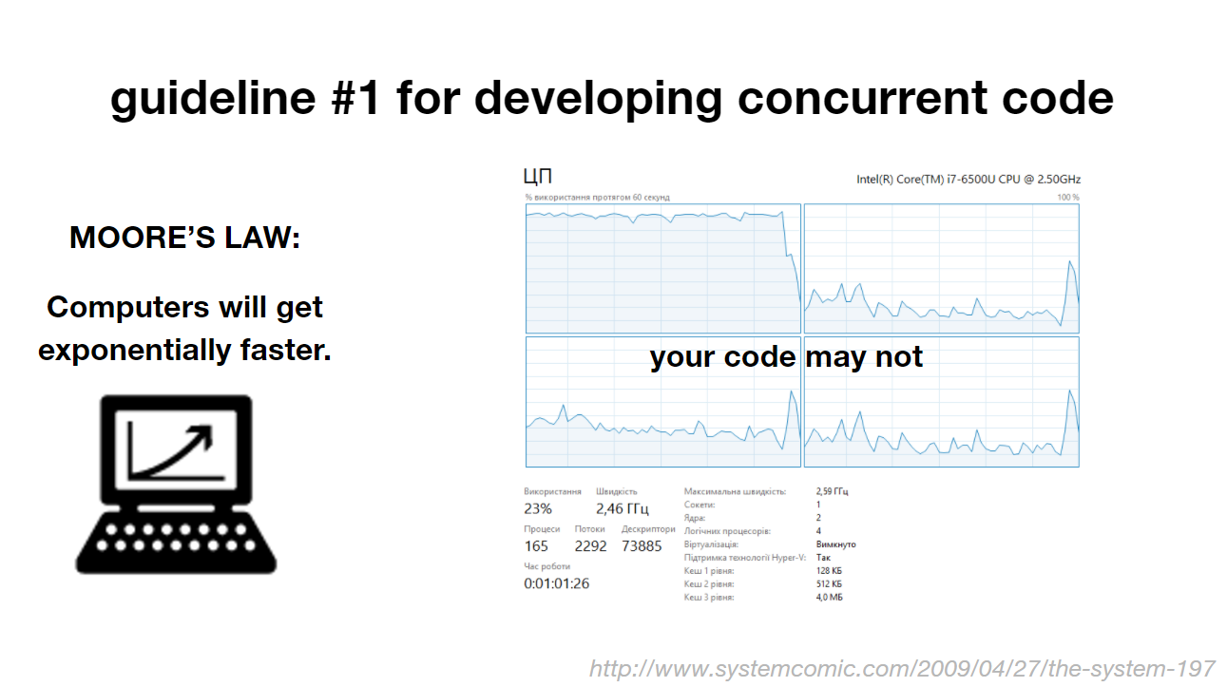
LESSONS LEARNED

Slide 155
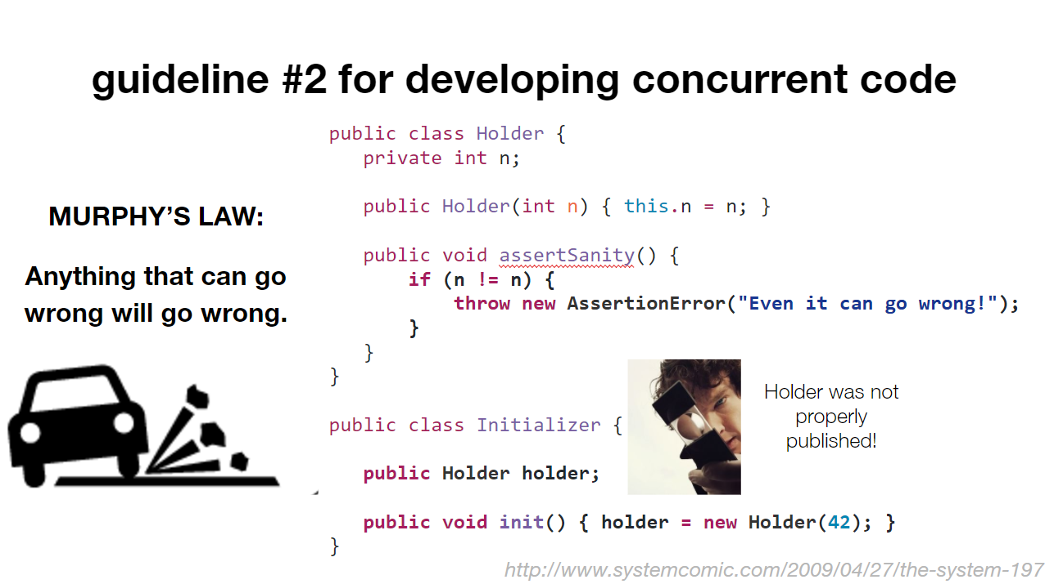
LESSONS LEARNED

Slide 156
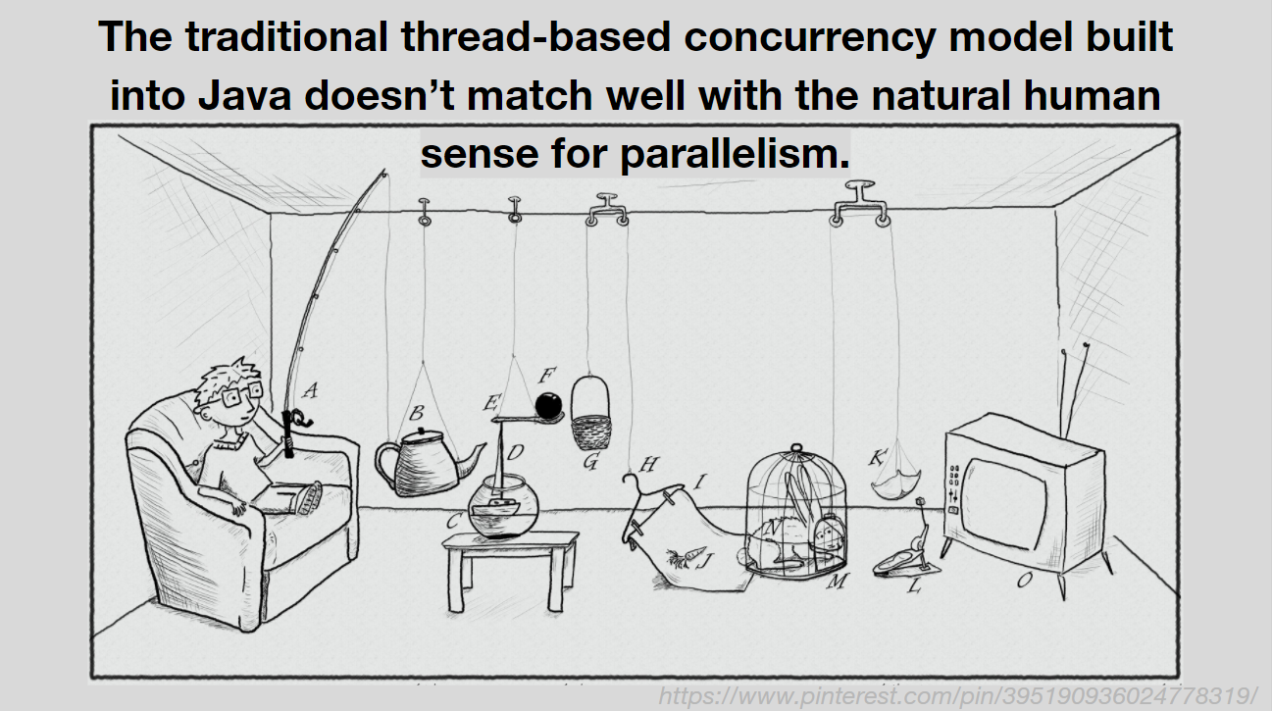
LESSONS LEARNED

Slide 157
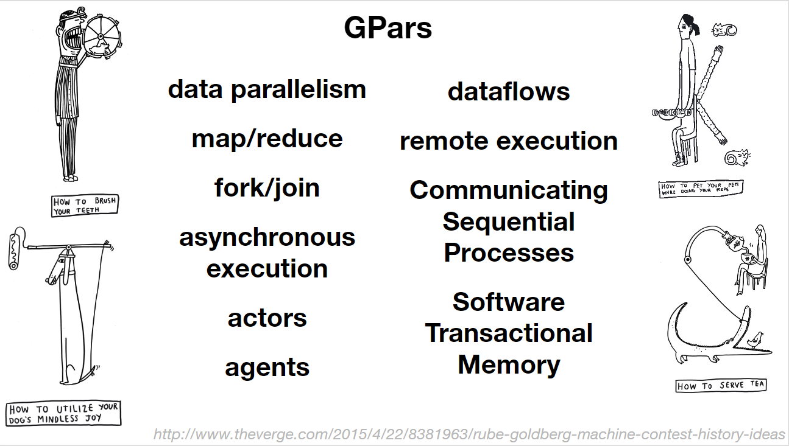
LESSONS LEARNED

Slide 158
LESSONS LEARNED
Java 8 Streams API is better

Slide 159
LESSONS LEARNED
for all long-running tasks

Slide 160
LESSONS LEARNED
protect inevitably mutable objects

Slide 161
LESSONS LEARNED
define tasks and explicitly coordinate them

Slide 162
LESSONS LEARNED
define operations on data

Slide 163
LESSONS LEARNED
learn more if you are interested

Slide 164
LESSONS LEARNED
integrate different concepts

Slide 165
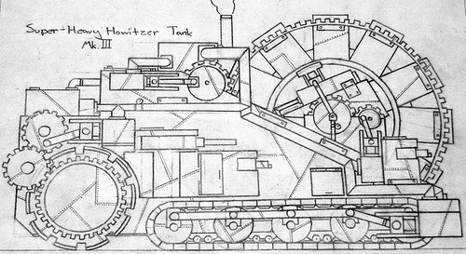
LEARN MORE IF YOU ARE INTERESTED
Groovy and Concurrency with GPars by Paul King
Gpars: Concurrency in Java & Groovy by Ken Kousen
Official site
Sources
Slack channel
The GPars User Guide
'Concurrent Groovy with GPars' chapter from 'Groovy in Action' book
https://s-media-cache-ak0.pinimg.com/originals/94/7b/55/947b558df61fd46caa6d041c1a21bb40.jpg

Slide 166
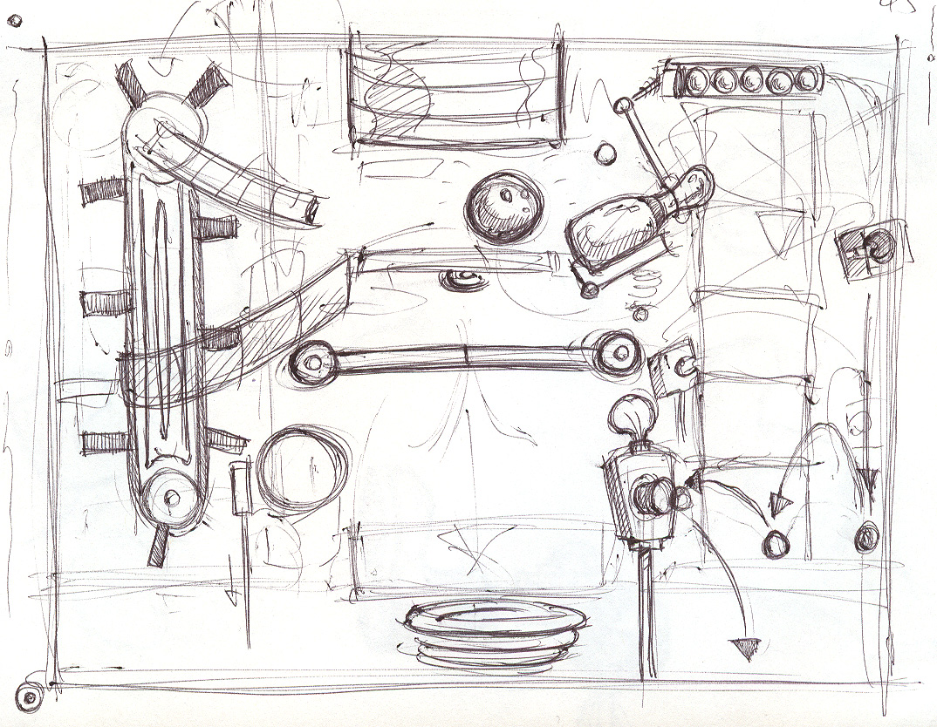
Q/A
THANK YOU!
http://sweetlygrotesque.blogspot.com/2012/01/concept-sketches-goldberg-machine.html

